Slide 1
Information security awareness
By: Oluwabunmi Olanrewaju
COMP 249-001 (Information Security, Privacy and Ethic)

Slide 2
Contents
Definition of Information Security
Importance of Information Security Awareness
Types of Security Threats
Best Practice
Consequences of security violations
Standards and regulations requirements
Summary
Questions & Answers

Slide 3
Information SECURITY
Information Security is the protection of information and systems from unauthorized access, modification, disclosure, disruption or destruction.
Major objectives of Information security includes:
Confidentiality
Integrity
Availability

Slide 4
DEFINITION of Information Security Awareness
Information security awareness is a fundamental part of effective security management, it is a formal process of training and educating users about information protection.
It is necessary to educate all users within an organisation about potential threats to information, and taking reasonable steps to guard against such threats.
Who are the Users?
Management
Shareholders/ Owners
Employees
Business partners
Contractors
Customers / Clients
Regulators etc.

Slide 5
IMPORTANT of Information Security Awareness
Regulatory Requirements Compliance
Due Diligence
Ensure Accountability
Corporate Reputation

Slide 6
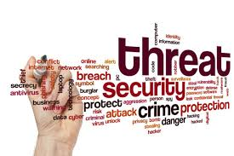
Types of Security Threats

Slide 7
THREATS
Threats can be object, person or other entity that represents constant danger to information asset and there are there categories namely:
Natural (such as fire, flood, lightening, Tornado, Power failures)
Unintentional: actions that occur due to lack of knowledge or carelessness
Intentional: Threats that are deliberately designed to harm or manipulate an information system, its software and/or data.

Slide 8
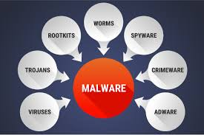
THREATS (Cont.…)
Malware: Short for Malicious Software, malware is any code that can be used to steal data, bypass access controls, or cause harm to, or compromise a system.

Slide 9
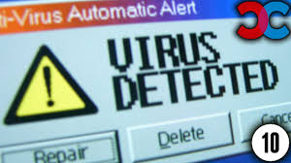
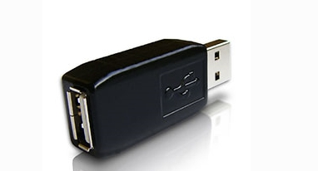
THREATS (Cont.…)
Virus is a computer program than can copy itself by modifying other computer programs and inserting its own code.
Worms are malicious codes that replicate themselves by independently exploiting vulnerabilities in networks. virus requires a host program to run, worms can run by themselves.
Spyware: This malware is designed to track and spy on the user. Spyware often includes activity trackers, keystroke collection, and data capture. Examples include keyloggers, rootkits etc.
Sample of a Hardware Keyloggers

Slide 10
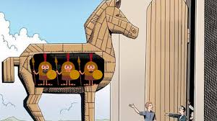
THREATS (Cont.…)
Trojan horse: A Trojan horse is any malicious computer program which misleads users of its true intent. for example where a user is duped into executing an e-mail attachment disguised to appear not suspicious
Some Symptoms of Malware include:
There is a decrease in computer speed.
The computer freezes or crashes often.
There is a decrease in Web browsing speed.
There are unexplainable problems with network connections.
Files are modified or deleted.
There is a presence of unknown files, programs, or desktop icons.
There are unknown processes running.
Programs are turning off or reconfiguring themselves.
Email is being sent without the user’s knowledge or consent.

Slide 11
THREATS (Cont.…)
Social engineering: it is an access attack that attempts to manipulate individuals into performing actions or divulging confidential information.
Types of social engineering attacks:
Pretexting - This is when an attacker calls an individual and lies to them in an attempt to gain access to privileged data.
Tailgating - This is when an attacker quickly follows an authorized person into a secure location
Something for Something - This is when an attacker requests personal information from An individual in exchange for something, like a free gift.
https://www.youtube.com/watch?v=_G3NT91AWUE

Slide 12
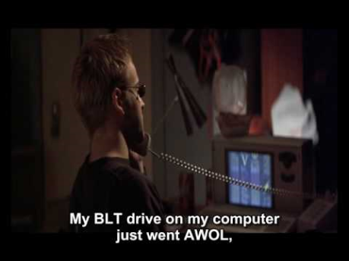

Slide 13
THREATS (Cont.…)
Hacking: It is a term used to describe actions taken by someone to gain unauthorized access to a computer.
Spam: It is the use of messaging systems to send an unsolicited message, especially advertising.
Phishing: It is when a malicious party sends a fraudulent email disguised as being from a legitimate, trusted source. The message intent is to trick the recipient into installing malware on their device, or into sharing personal or financial information. An example of phishing can be seen in next slide

Slide 14
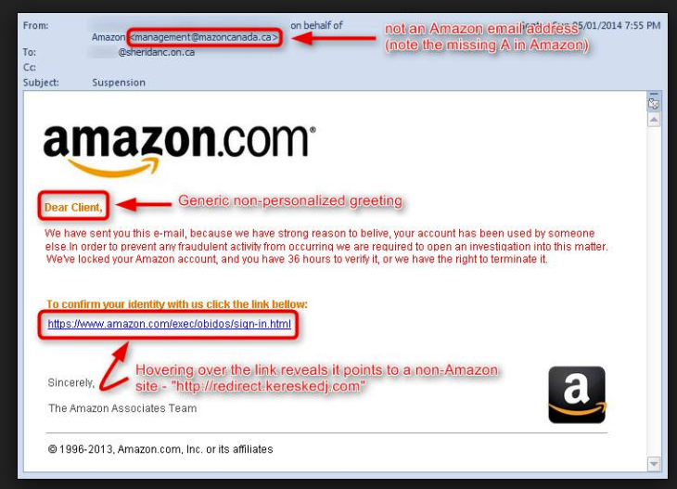

Slide 15
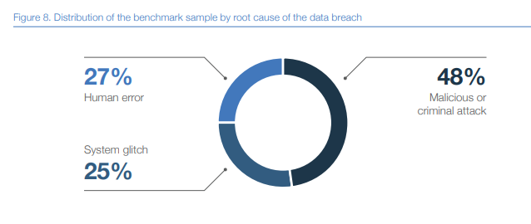
Source: 2018 Global cost of data Breach Report by Ponemon Institute LLC

Slide 16
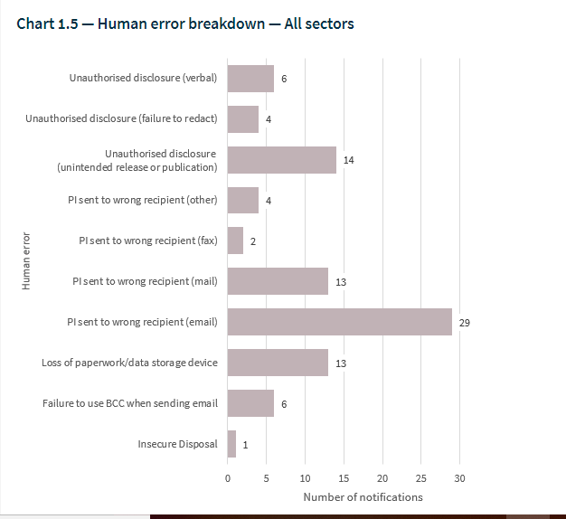

Slide 17
Notable incidents
US Universities: In March 2018, Department of Justice indicted nine Iranian hackers that infiltrated 144 US universities, 176 universities in 21 other countries, 47 private companies, and other targets like the United Nations, the US Federal Energy Regulatory Commission, and the states of Hawaii and Indiana. The attacks used carefully crafted spear phishing emails to trick professors and other university affiliates into clicking on malicious links and entering their network login credentials.
eBay: in 2014, a group of attackers leveraged phishing attacks to steal the credentials of as many as 100 eBay employees. They used that information to gain access to eBay's internal network.
BlackRock Inc.: earlier in the year, a user at BlackRock accidentally posted spreadsheets of sales information to a public part of the website.

Slide 18
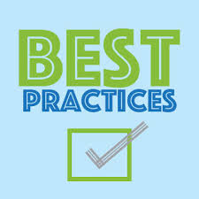
Best Practices IN SECURING INFORMATION

Slide 19
Safe email practice
Do not open email attachment unless you are sure what they are
Delete spam or suspicious emails, do not open, forward or reply them
Be mindful of phishing emails asking for personal or sensitive information

Slide 20
PYSICAL SECURITY
Physically secure all mobile devices at all times: lock them up securely before you step away
In shared printer areas, immediately remove all sensitive documents from equipment.
Use a paper shredder or secure shred bin when throwing out personal or sensitive information.
Clear desk of papers including sticky notes and papers that contain sensitive information.
Set up your workstation so that unauthorized people and passers-by cannot see sensitive information on your monitor.
Securely delete all contents of computers and mobile devices, before discarding, exchanging, selling or donating them.

Slide 21
Securing your computer
Enable automatic software updates where available
Install and update antivirus software
Install and configure firewall software
Do not automatically connect to public wireless networks
Disconnect your computer from the wireless network when it is not in use
Use caution when downloading and installing software
Lock your computer when it is unattended

Slide 22
PASSWORDS
Do not reveal your passwords to anyone
Avoid writing your passwords down.
Change default passwords the first time you log in.
Avoid using the same password for all devices.
Change password immediately if you discover someone's aware of it.
Use strong, unique passwords using the following guidelines:
Use passwords that are more than 8 characters in length.
Use a combination of upper and lowercase letters, numbers, and special characters in passwords.
Avoid using common words such as password or administrator, or know facts such as pet names or date of birth etc.

Slide 23
Protecting Verbal Communication
Be mindful of your surroundings when discussing Restricted data
Do not discuss Restricted data with individuals who do not have a need to know

Slide 24
SAFE INTERNET AND SOCIAL NETWORKING USAGE
Do not reveal personal details or confidential information online.
If any web or Social Media content looks suspicious in any way, close your browser and do not return to that page.
Avoid using the same passwords for web sites that you use to access company system.
Do not click on links in pop-up ads/windows; Use your web browser’s pop-up blocker, if it has one, to help prevent these ads from getting through.
When visiting a website, look for the lock in the browser address to ensure that the site is SSL (Secure Sockets Layer) encrypted

Slide 25
INCIDENT RESPONSE
An Information Security Incident is an adverse event in an information system that poses a threat to computer or network security in respect of availability, integrity and confidentiality. Example include:
Direct loss or theft of Classified Information (e.g. papers taken from car, post intercepted, unauthorized download)
Loss or theft of equipment used to store Classified Information (e.g. laptop, smartphone, USB stick)
Corruption or unauthorized modification of vital records (e.g. alteration of master records)
Computer system or equipment compromise (e.g. virus, malware, denial of service attack)
Compromised IT user account (e.g. spoofing, hacking, shared password)
Break in at a location holding critical information processing equipment such as servers
Promptly notify the appropriate staff if you become aware of a possible security incident

Slide 26
Consequences of Security Violations on the part of the user
Loss of personal and confidential information
Loss of trust in the user and sometimes can leads to embarrassment of bad reputation
In a situation of compromise of sensitive information, it can lead to bad reporting
Disciplinary action which might include penalties, termination of employment or lawsuits

Slide 27
Standards and regulations requirements
ISO/IEC 27001 and 27002
8.2.2: All employees of the organization and, where relevant, contractors and third-party users should receive appropriate awareness training and regular updates in organizational policies and procedures, as relevant for their job function.
PCI DSS 12.6:
Make all employees aware of the importance of cardholder information security.
Educate employees (for example, through posters, letters, memos, meetings, and promotions).
Require employees to acknowledge in writing that they have read and understand the company’s security policy and procedures. In a situation of compromise of sensitive information, it can lead to bad reporting
CobiT
PO7.4 Personnel Training: Provide IT employees with appropriate orientation when hired and ongoing training to maintain their knowledge, skills, abilities, internal controls, and security awareness at the level required to achieve organizational goals.

Slide 28
SUMARRY
Nowadays, attackers are now turning to more targeted attacks focused on tricking users into clicking links or opening attachments in order to infiltrate company network.
SO, DO NOT BE THE WEAK LINK!!!

Slide 29
References
https://resources.infosecinstitute.com
CISCO Networking Academy
Building an Information Security Awareness Program (FIRST EDITION by Bill Gardner and Valerie Thomas)
Information Security and Employee Behaviour How to Reduce Risk Through Employee Education, Training and Awareness by ANGUS McILWRAITH
https://www.wired.com/story/2018-worst-hacks-so-far/
https://www.farmprogress.com/technology/3-ways-prevent-russian-hacking
https://www.augustadatastorage.com/know-cost-data-breach-2018/
https://www.powershow.com/view0/786844-YjAwY/Employee_Information_Security_Awareness_Training_powerpoint_ppt_presentation
https://www.slideserve.com/gaetan/it-security-awareness-information-security-is-everyone-s-business
https://www.oaic.gov.au/privacy-law/privacy-act/notifiable-data-breaches-scheme/quarterly-statistics-reports/notifiable-data-breaches-quarterly-statistics-report-1-july-30-september-2018

Slide 30
